Slide 1
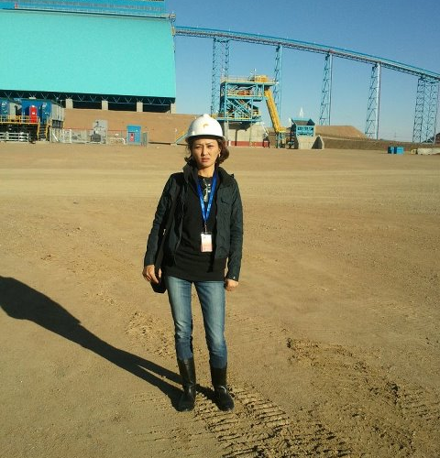
Oyu Tolgoi
My article about

Slide 2
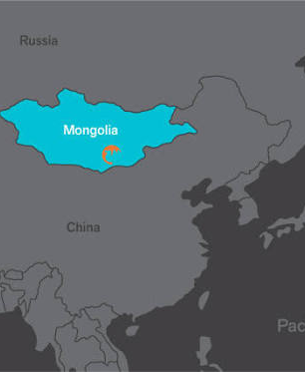
Deposit
The Oyu Tolgoi deposit, located in Khanbogd soum, Umnugovi aimag, Mongolia, was formed 5,000 years ago. Geologists believe that the Oyu Tolgoi deposit was formed by the eruption of the Tan Shan volcano and the resulting seismic activity.

Slide 3
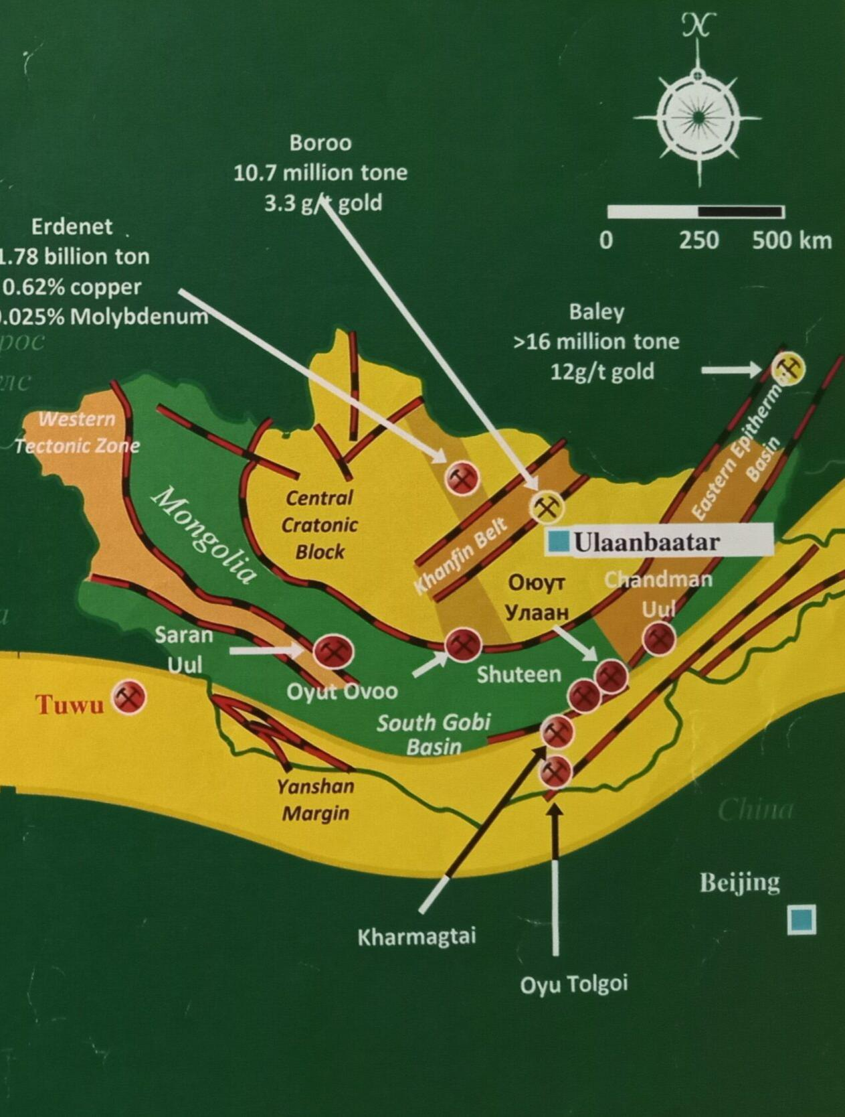
Discovery
The Oyu Tolgoi deposit, located in Khanbogd soum, Umnugovi aimag, Mongolia, was explored by the Canadian company Ivanhoe Mines. In 2011, the company determined that Oyu Tolgoi has three groups of deposits.

Slide 4
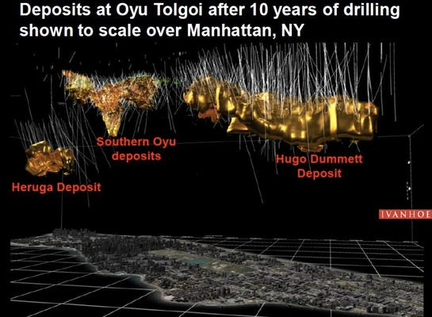
Reserves
The Oyu Tolgoi deposit consists of three groups of deposits: Heruga, Hugo Dummett, and Oyu, with proven reserves of 31 million tons of copper and 1,200 tons of gold. Two of them are underground and one is an open pit. The Oyu Tolgoi deposit is ranked among the largest in Mongolia and the world in terms of gold and copper reserves.

Slide 5
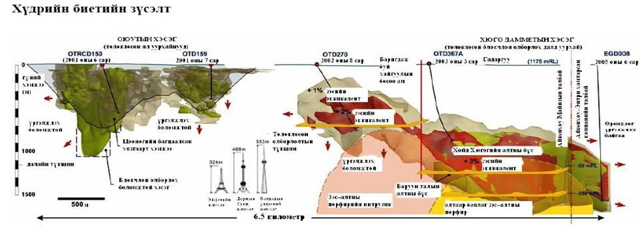
Golden Triangle, Heruga, Hugo Dammet

Slide 6
Golden Triangle
Ivanhoe Mines discovered high-grade copper ore when drilling hole 105. Two more holes drilled nearby also found high-grade copper ore. These three holes are known as the “Golden Triangle.” Sometimes referred to as the “Southern Turquoise” open pit.

Slide 7
Heruga
Heruga is a Sanskrit word meaning peace. Therefore, the origin of this name is explained by the Demcho Monastery, an energy center located near the Oyu Tolgoi deposit. It is believed that the monks of the Demcho Monastery called the area Heruga, and later named the place where the deposit was discovered.

Slide 8
Hugo Dummet
Hugo Dummett became a vice president at Ivanhoe Mines in 2001. He discovered one of the underground mines in the Oyu Tolgoi deposit. Therefore, one of the underground mines in Oyu Tolgoi is named after Hugo Dummett. Hugo Dummett is a famous prospector who discovered the “Ekati” diamond mine.

Slide 9
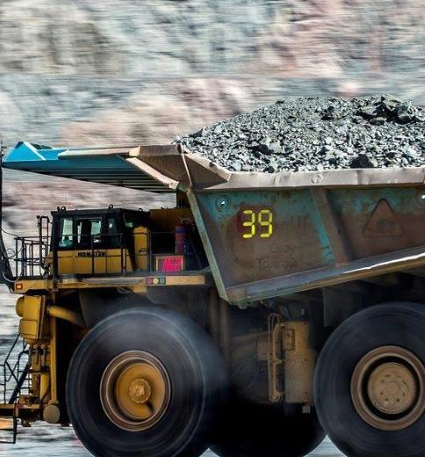
Open Pit
Production:
Ore mining began at the Oyu Tolgoi open pit in 2011.
The enrichment plant was commissioned in 2012.
In 2013, the export of open pit concentrate began.
Copper in concentrate 150,000 – 180,000 tons per year
Gold production is 400,000 – 550,000 ounces per year.

Slide 10
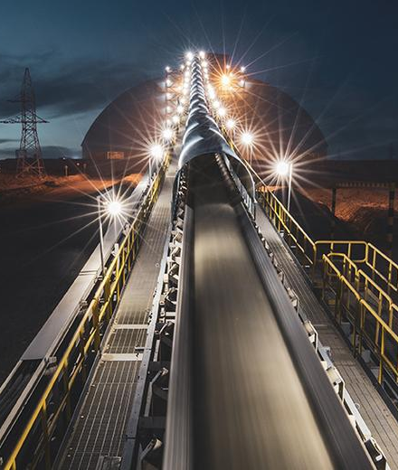
Underground Mining production:
In 2023, the Oyu Tolgoi underground mine began production.
It will be the world’s fourth largest copper mine by 2030.
The Oyu Tolgoi open-pit and underground mines will produce an average of 500,000 tons of copper per year between 2028 and 2036.

Slide 11
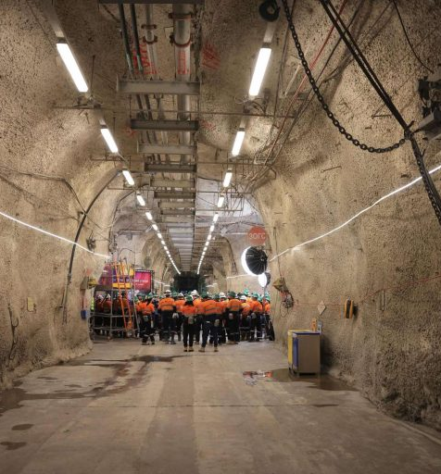
Economic benefits by the end of 2024:
Investment : Rio Tinto has invested approximately $17 billion in Oyu Tolgoi.
Taxes: Oyu Tolgoi has collected over 12 trillion tugriks in taxes into the state budget.
Exports : The Oyu Tolgoi project accounts for about 20 percent of our country’s total exports and more than 40 percent of foreign exchange reserves.

Slide 12
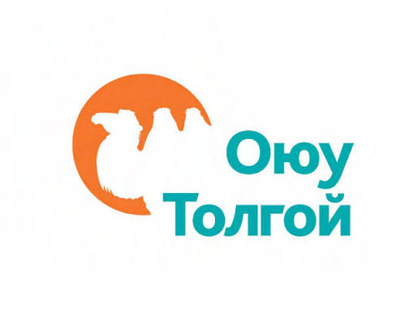
Oyu Tolgoi Investment Agreement
In 2009, the Government of Mongolia signed an investment agreement for Oyu Tolgoi with Ivanhoe Mines Mongolia Inc., Ivanhoe Mines Limited, and Rio Tinto International Holdings Limited.

Slide 13
Underground mining development contract
In 2015, the Government of Mongolia, Erdenes Oyu Tolgoi LLC, Turquoise Hill Resources Limited, and Rio Tinto signed a development plan document for the Oyu Tolgoi underground mine. This is known as the “Dubai Agreement.”

Slide 14
Shareholders
Mongolian government
Turquoise hill

Slide 15
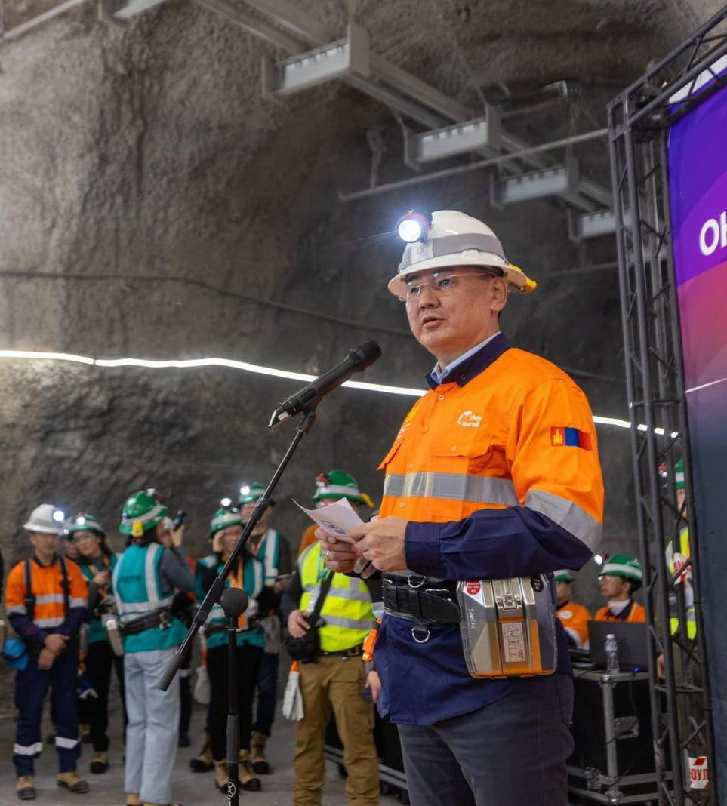
The world’s 4th largest copper mine
In 2015, the Government of Mongolia, Erdenes Oyu Tolgoi LLC, Turquoise Hill Resources Limited, and Rio Tinto signed a development plan document for the Oyu Tolgoi underground mine. This is known as the “Dubai Agreement.”

Slide 16
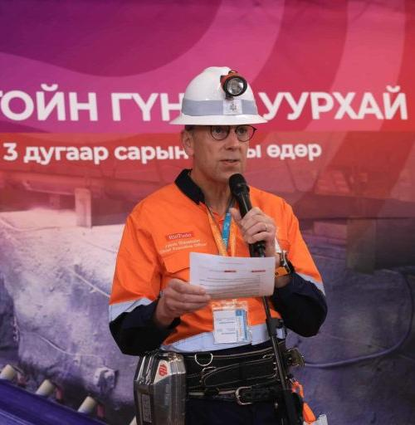
The largest copper producer
Following the opening of the Oyu Tolgoi underground mine, Rio Tinto Group CEO Jakob Stausholm said: “Oyu Tolgoi has taken the first step towards becoming one of the world’s largest copper producers.”

Slide 17
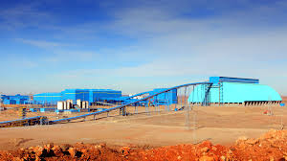
Thank you
Source: dailypost.mn

