Slide 1
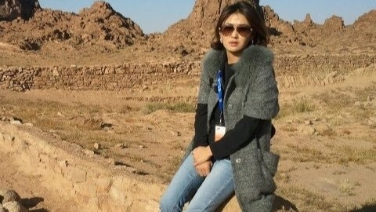
Oyutolgoi
My article about largest Mongolian mining company

Slide 2
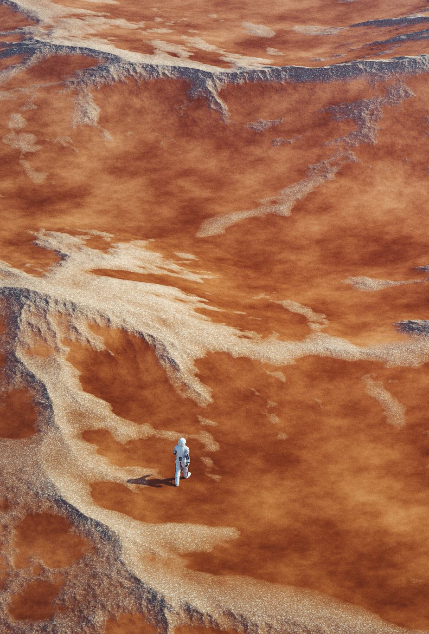
History of the Oyu Tolgoi deposit
How are natural resources formed? On the one hand, there are deposits formed when a large meteorite falls on the Earth. On the other hand, deposits are formed when volcanoes erupt and underground minerals flow through seismic cracks. Scientists believe that 5-7 thousand years ago, the Tan Shan volcano erupted, the earthquake shook, and underground minerals flowed through the cracks, forming the Oyu Tolgoi deposit located in Khanbogd soum, Umnugovi aimag. Ivanhoe mines conducted exploration in this deposit alone and discovered the first part of the Oyu Tolgoi group of deposits in July 2011. After continuing the exploration work, it was determined that Oyu Tolgoi has three groups of deposits. In other words, it was determined that Oyu Tolgoi has three groups of deposits: Heruga, Hugo Dummett, and Yumdum Oyu, with proven reserves of 31 million tons of copper and 987 thousand tons of gold. Heruga and Hugo are underground mines, while Oyu is an open pit mine.

Slide 3
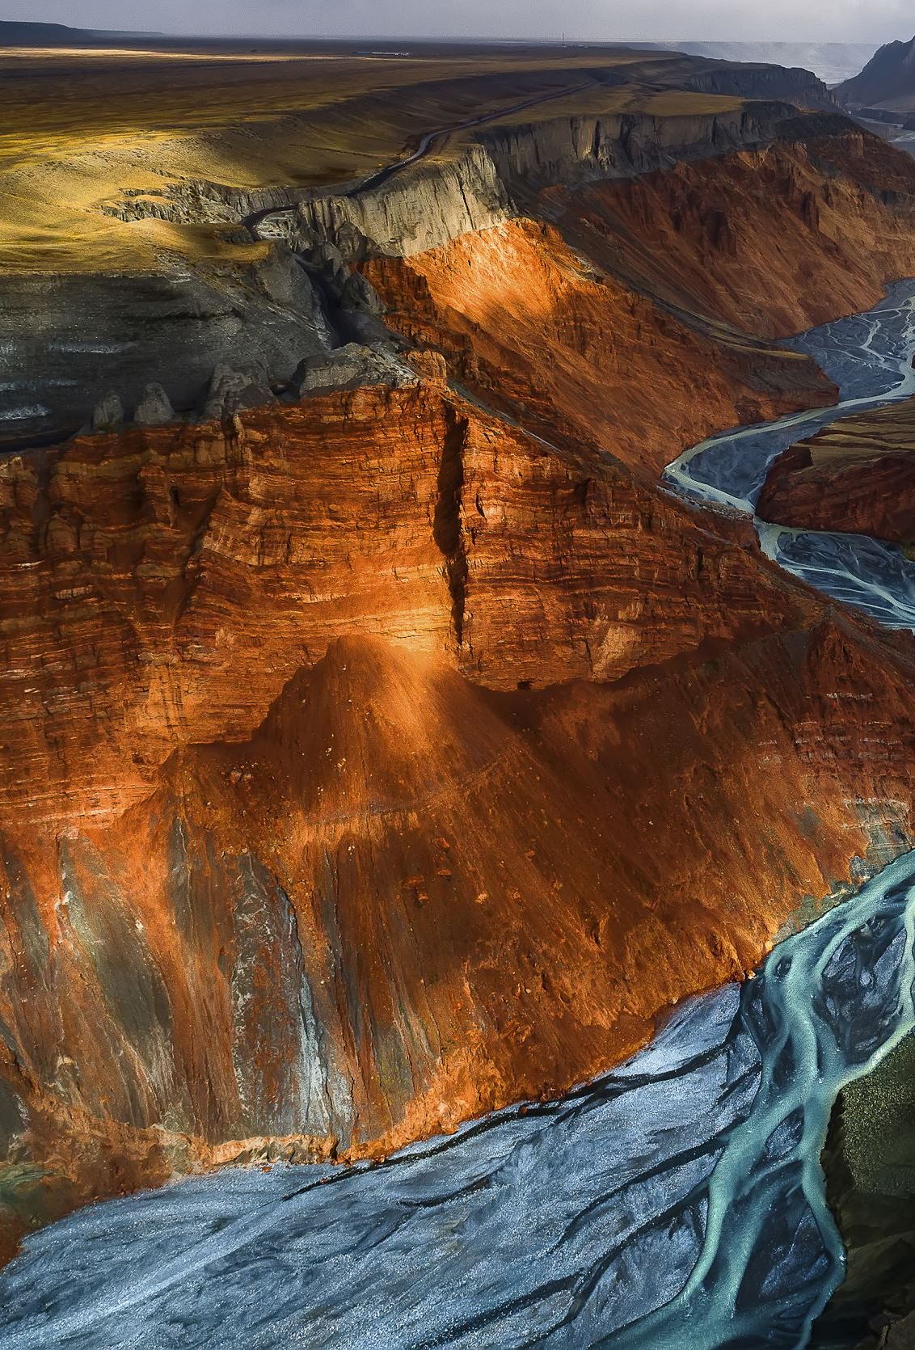
Oyu Tolgoi open pit Oyu
Ivanhoe Mines initially drilled shallow holes, but they were unsuccessful, so they later drilled hundreds of holes to a depth of 500 meters to discover the reserves. Despite spending a lot of money on this, Ivanhoe Mines was forced to leave Mongolia because they did not find anything significant. However, as a last resort, drilling hole number 105 discovered high-grade copper ore. Subsequently, two more holes were drilled near that hole, and high-grade copper ore was again discovered. These three holes, which became the stars of salvation, are called the “Golden Triangle”. This is the current Oyu Tolgoi open pit mine. A few years ago, while I was there on business, the local press representative Ganzorig brought something from the place called the Golden Triangle copper ore. It was like a star in the sky, scattered in fine gray stone. In fact, this is called Oyu Tolgoi copper ore.

Slide 4

Oyu Tolgoi Underground Mine Heruga
One underground mine is called Heruga, which is a Sanskrit word meaning peace. When you go to the Ouyu Tolgoi deposit in Khanbogd soum, Umnugovi aimag, there is the Demcho monastery. The monks of the Demcho monastery called the area Heruga, so it is possible that the place where the deposit was discovered was named that way.

Slide 5

Oyu Tolgoi Underground Mine Hugo Dummett
The Oyu Tolgoi mine is named after the man who discovered the other underground mine, Hugo Dummett. The real name of this man is Hugo T. Dummett. Hugo Dummett was born in 1940 and died in 2002. He was an exploration geologist known for his role in the discovery of the Ekati diamond mine in northwestern Canada. In 2001, Dummett became a vice president at Ivanhoe Mines, where he began to participate in the discovery of the large porphyry gold and copper deposits at the Oyu Tolgoi mine.

Slide 6

Thank you
All

